Slide 1

Detection of DNS over HTTPS using Semi-supervised Machine Learning
National Institute of Technology Karnataka
Surathkal, Karnataka, India 575025
VamshiKrishna M
Jithendra Sri SivaKesava Siddartha Puppala
Sai Deepak G

Slide 2
Problem Statement
Detection of DoH using Semi supervised learning
Encryption - Advantage
Prone to malicious attacks - Disadvantage
Why machine learning?
Why semi supervised learning?
Notes:
Benefit is that encrypting DNS name resolution traffic helps to hide your online activities
DoH also helps to prevent DNS spoofing and man-in-the-middle
DOH is already supported natively in all most popular web browsers
DNS traffic can identify many security threats that are observable in the network traffic
Since the communication via DoH (DoT as well) is encrypted and visible only to the user and his DoH service provider, profiling is practically impossible
DoH can also be problematic in the enterprise
Finally, we studied whether ML algorithms can detect the identified DoH communications patterns. Our analysis is based on bidirectional IP Flows extended with per-packet information (PPI). Besides the traditional IP Flow information (such as IP addresses, ports, and the amount of transferred data), we also have lengths of individual packets and their timestamps. The PPI is general enough for creating discriminative features to classify DoH from regular traffic
We consequently filtered the DoH packets by the IP address of the DoH resolver and analyzed them for the protocol implementations. Some of the DoH connections were also decrypted (using exported cryptographic keys) to understand the contents of each packet
This new feature also brings some threats because various security tools depend on readable information from DNS to identify, e.g., malware, botnet communication, and data exfiltration.

Slide 3
Key Words
DNS (Domain Name System)
DoH (DNS over HTTPS)
Machine Learning
Semi-Supervised Learning
Notes:
Deep learning - advantage - Learn suitable features automatically without mentioning it specifically
Semi-supervised - Data is less

Slide 4
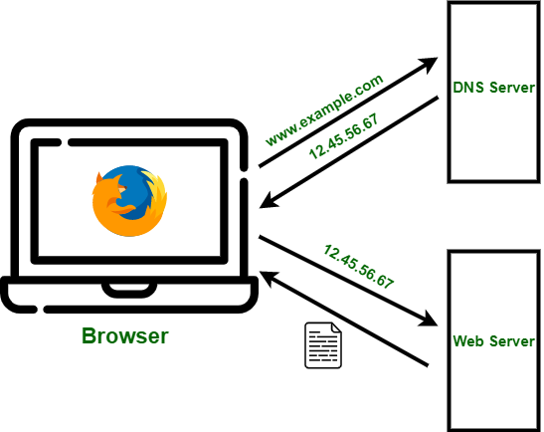
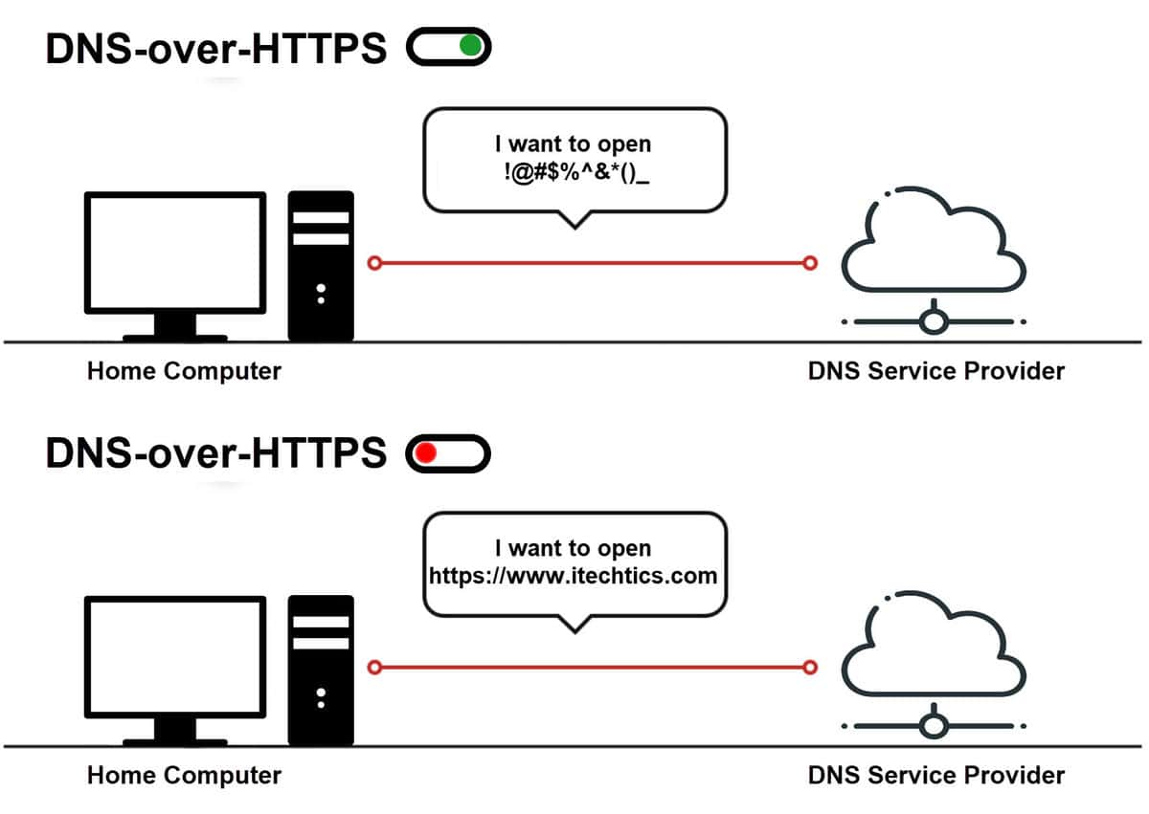
Definitions
DNS - Domain Name System
- DNS server converts a hostname into an numerical address.
DoH - DNS over HTTPS
- DOH encrypts DNS traffic by passing queries through a HTTPS encrypted session

Slide 5

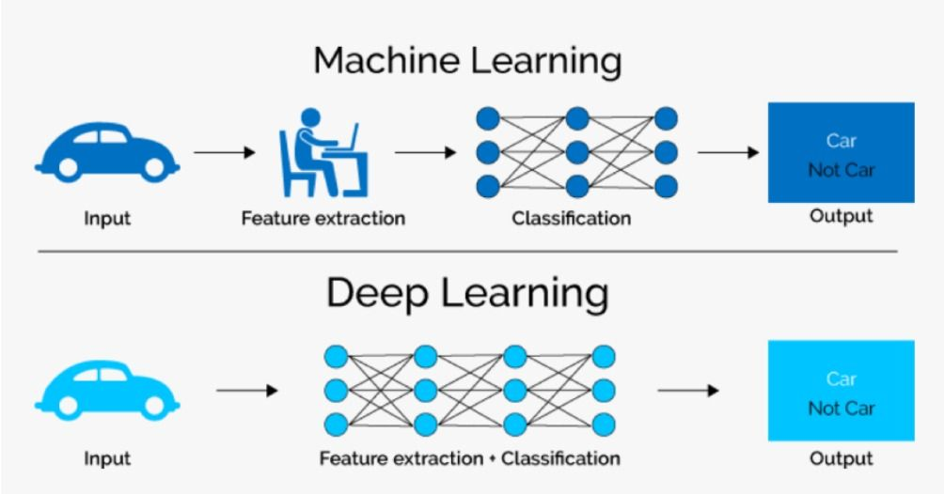
Definitions
Machine Learning
- The use of data and algorithms to imitate human learning
Deep Learning
- The processing of data in way inspired by human brain to achieve AI
Notes:
Machine learning - The use of data and algorithms to imitate the way that humans learn, gradually improving its accuracy
Deep learning - teaches computers to process data in a way that is inspired by the human brain

Slide 6
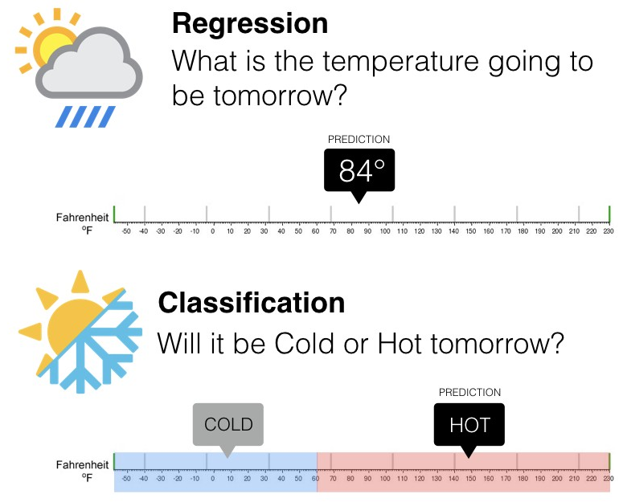
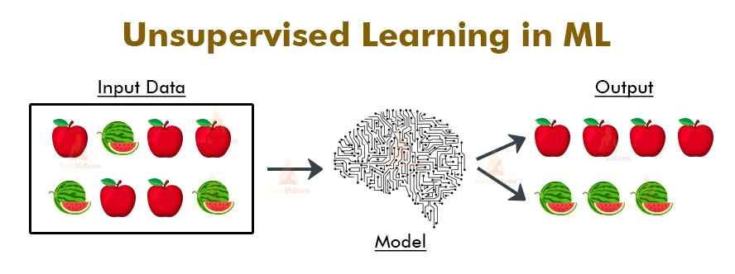
Definitions
Supervised Learning
- Regression, Classification
Unsupervised Learning
- Clustering
Notes:
combines supervised and unsupervised learning. The technique relies on using a small amount of labeled data and a large amount of unlabeled data to train systems

Slide 7
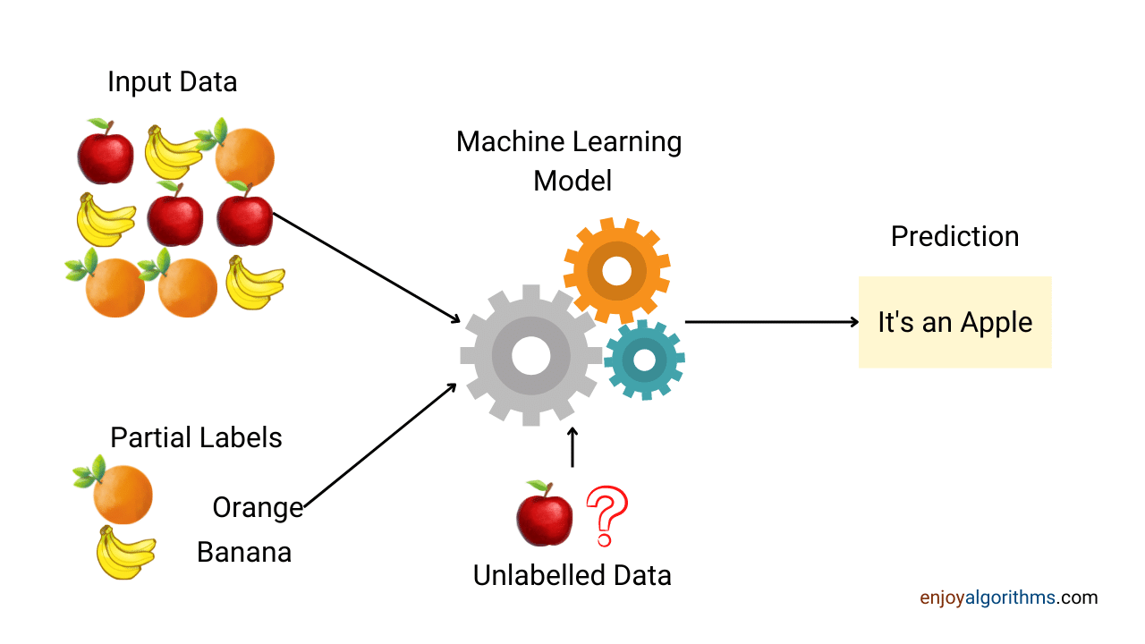
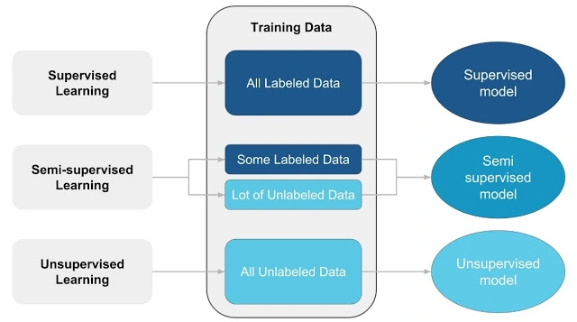
Definitions
3. Semi-Supervised Learning
- Combination of Supervised and Unsupervised learning
- Uses small amount of labeled data
- Uses large amount of unlabeled data
Notes:
combines supervised and unsupervised learning. The technique relies on using a small amount of labeled data and a large amount of unlabeled data to train systems

Slide 8
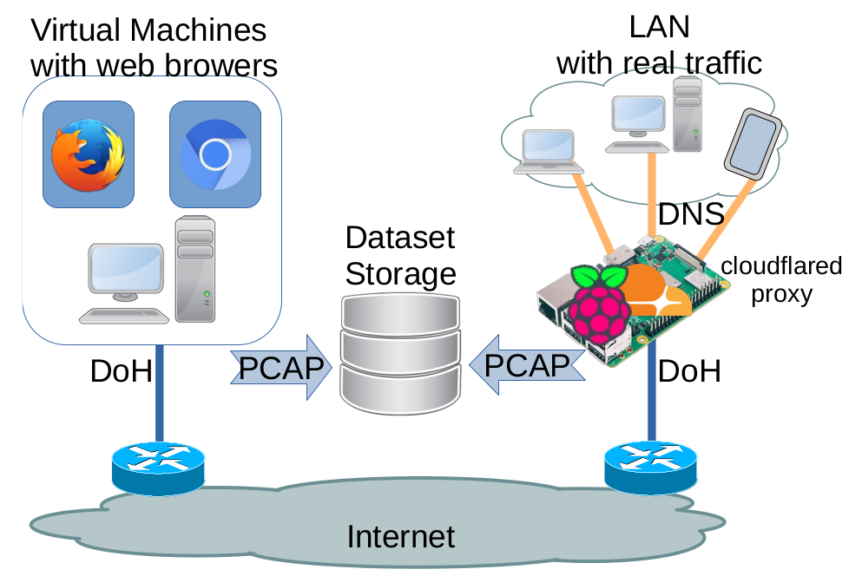
Methodology
1. Data Collection
The first option is to enable DoH in the web browser.
The second way is to redirect all traditional DNS queries via a central DoH proxy, which translates DNS queries to DoH
Collect PCAP data and export it as IP flows using flow_meter exporter
Used PStat plugin - for packet-level statistics
Ref. Dmitrii Vekshin et al https://doi.org/10.1145/3407023.3409192

Slide 9
Methodology
2. Data Preprocessing
Partition the collected data
Divide the raw dataset with features in a fair ratio for supervised and unsupervised training (say 20:80)
Data labeling
Take the small partition and label them whether they are DoH or not
The DoH labels need to be given reliably according to our proxy setup
For manually generated traffic give labels according to known IP addresses of the DoH services and target HTTPS servers.
Unlabeled data
Used for unsupervised model

Slide 10
Methodology
3. Semi supervised training
Supervised model
Train using labeled data
Unsupervised model with pseudo labels
Train using unlabeled data
Link labels
Link the labels with pseudo labels
Final supervised model
Combine newly labeled and previously labeled data
Train a supervised model on it

Slide 11
Results
Model | Test Accuracy | Time
Logistic Regression | 97.25956% | < 1min
SGDClassifier | 97.25956% | < 1min
KNN | 99.69056% | 9 min
Linear SVM | 99.75121% | 2 min
SVM | 99.75121% | 22 min
MLPClassifier | 99.92945% | 3 min
GradientBoostingClassifier | 96.01931% | < 1min
RandomForestClassifier | 99.99257% | 2 min
Decision Tree Classifier | 99.95049% | < 1min

Slide 12
Scope of Our Work Till Now
This work is focused on detection of DoH using Semi-Supervised learning techniques
It has been extended to detection of malicious DNS in DoH

Slide 13
Summary
Terminologies - DNS, DoH, ML, Semi-supervised
DNS over HTTPS
Data collection
Data preprocessing
Methodology

Slide 14
Q & A

Slide 15
Thank You

